Slide 1







Automated Meeting Room Booking System
"Effortless Booking for Your Meeting Success"

Slide 2

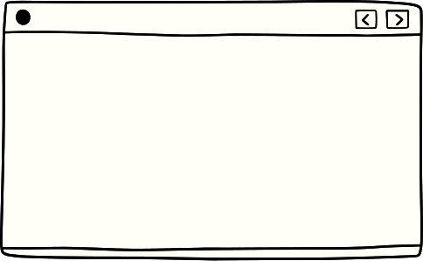



Contents
01
02
03
Introduction
The team
Login Page
04
05
06
Manager Page
Organize and Edit meetings
Admin Page

Slide 3


The team
SHREYA
TINA
MANALI
ANUSHKA
AKRITI
RAJ SHEKHAR
ANIMESH
JITESH

Slide 4
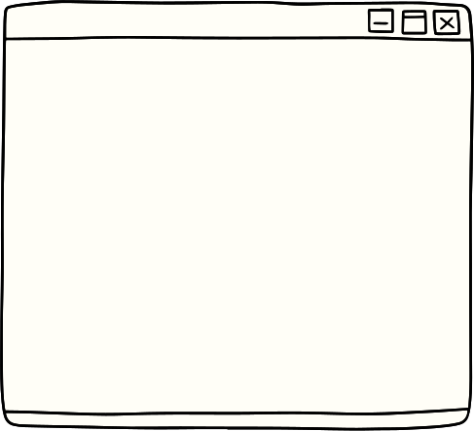


Introduction
In today's fast-paced and interconnected business world, effective communication and collaboration are paramount to success. Meeting rooms serve as hubs for innovation, brainstorming, decision-making, and team coordination. However, the process of booking these critical spaces can often be a cumbersome and time-consuming task, leading to frustration and inefficiency within organizations.

Slide 5
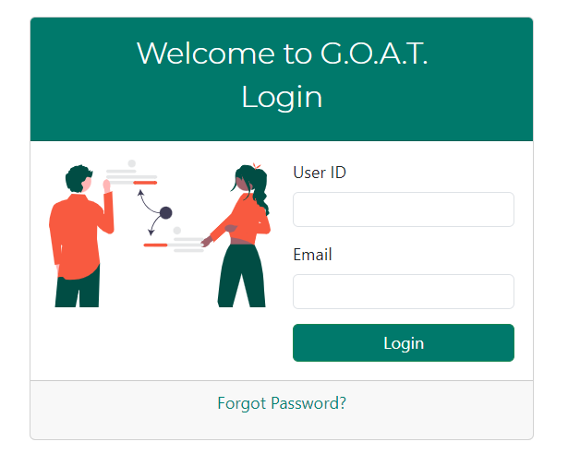
Login
01
Login as User
02
Login as Manager
03
Login as Admin

Slide 6
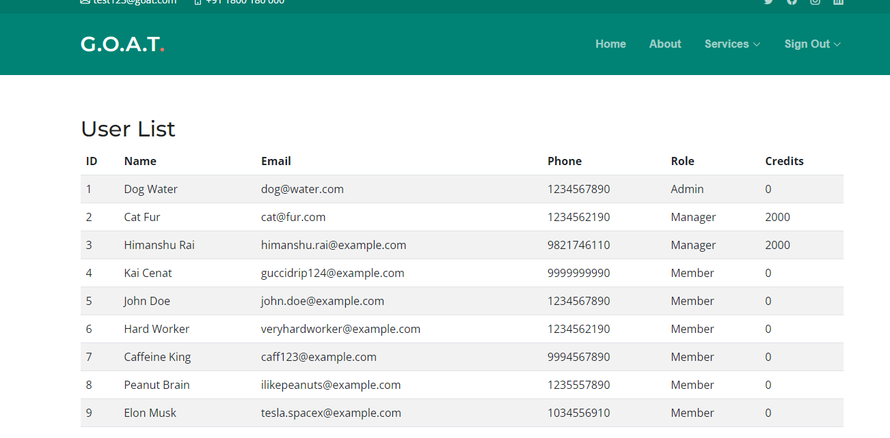
ALL Users

Slide 7
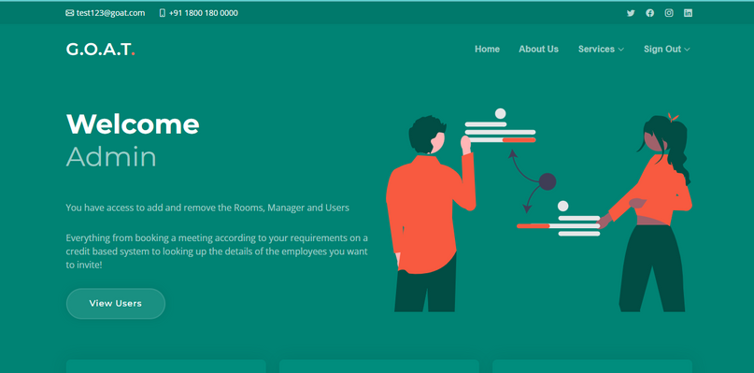
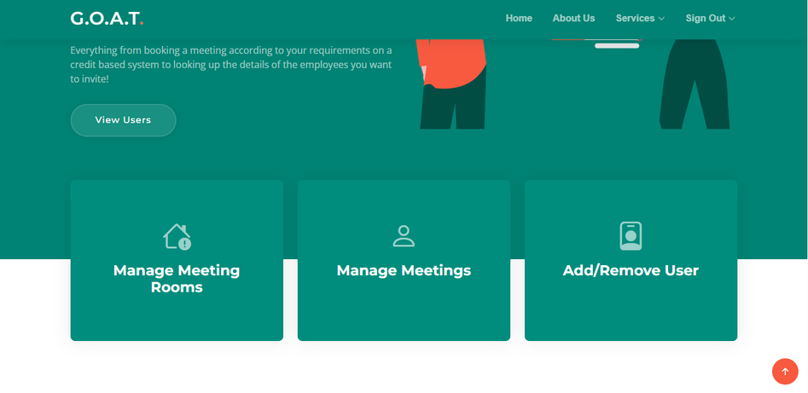
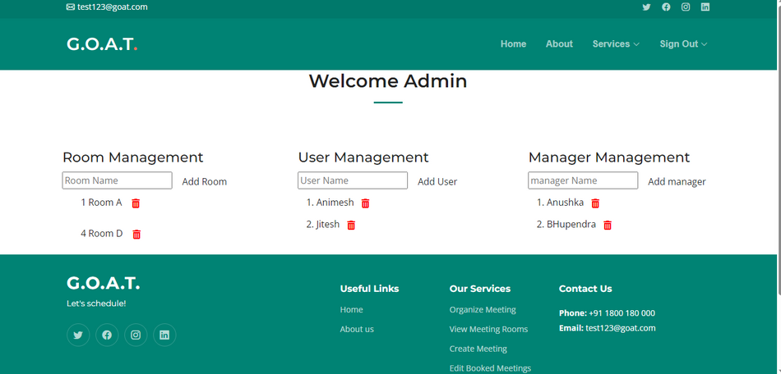
Admin Page
Admin can Add/remove Rooms, Manager and Users

Slide 8

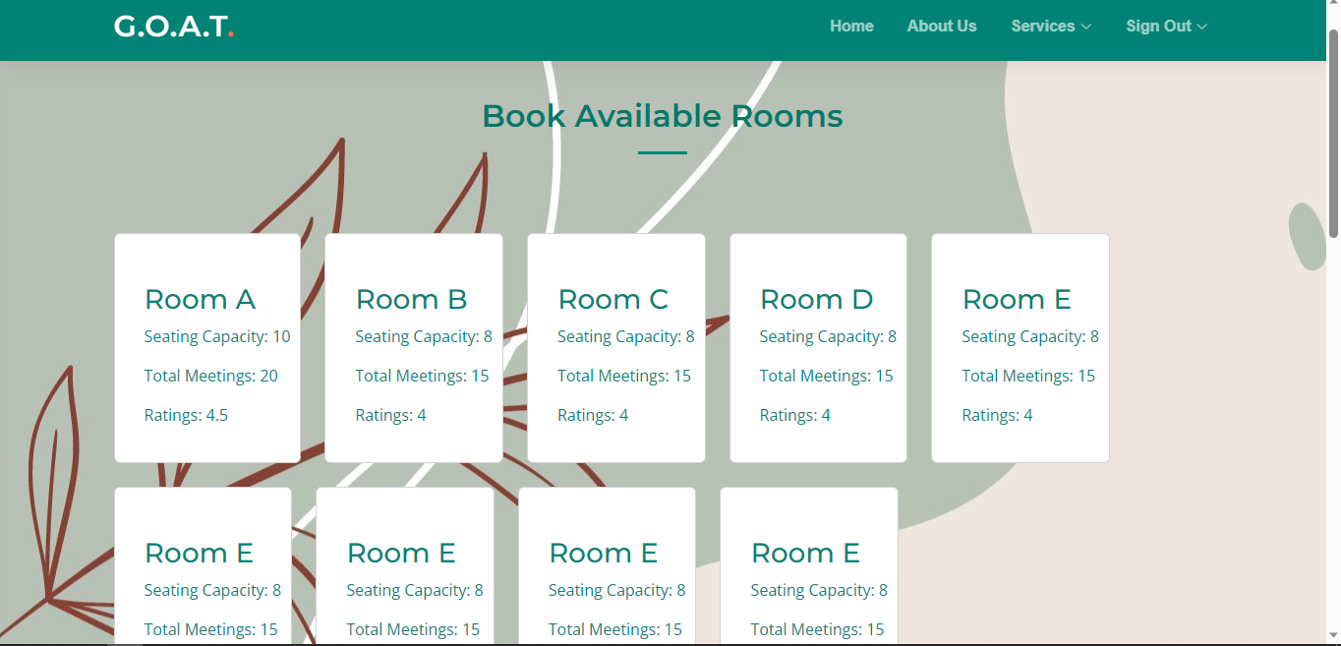



You can see available meeting rooms here and book them
Available Rooms

Slide 9
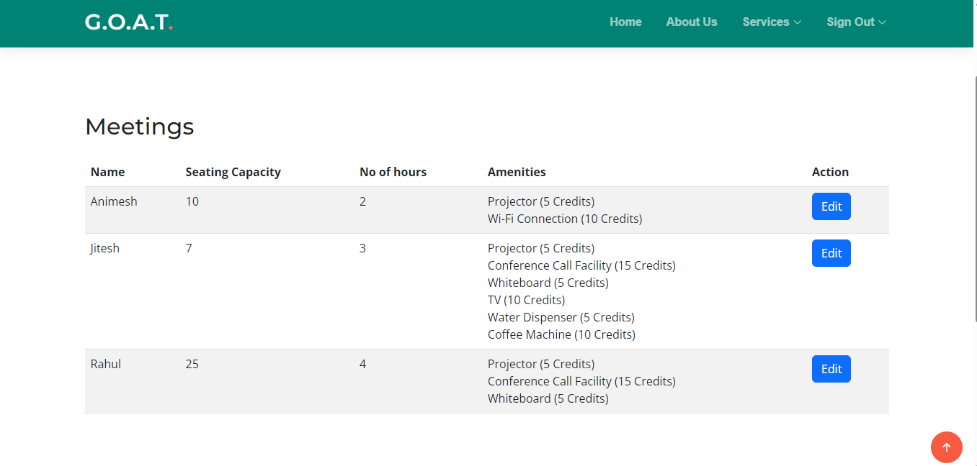


Edit Meeting
Click on Edit

Slide 10

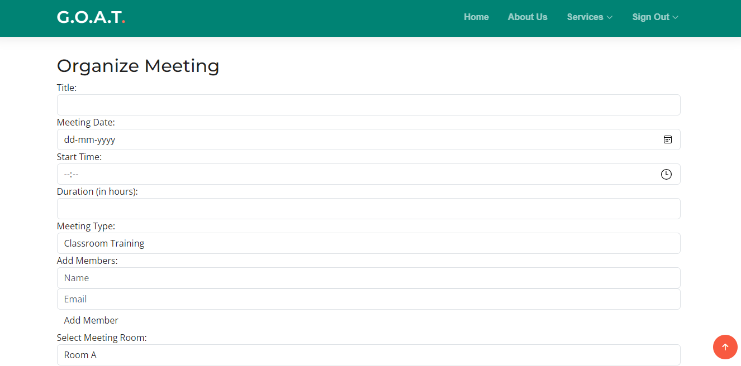



Organize Meeting
Enter Title here
Select Date and time.
Add member and select Room

Slide 11

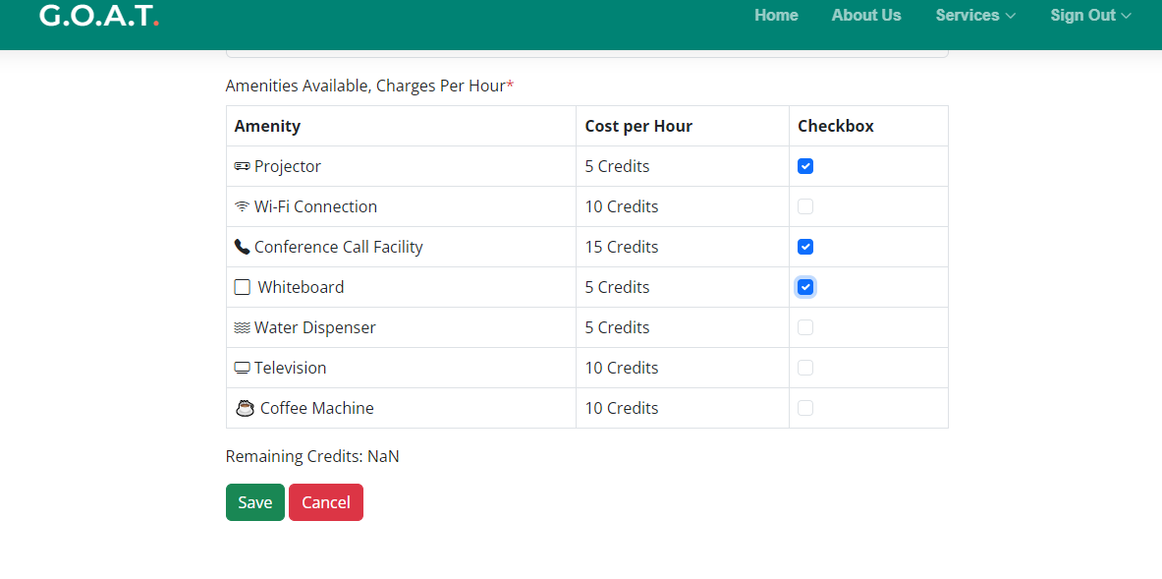
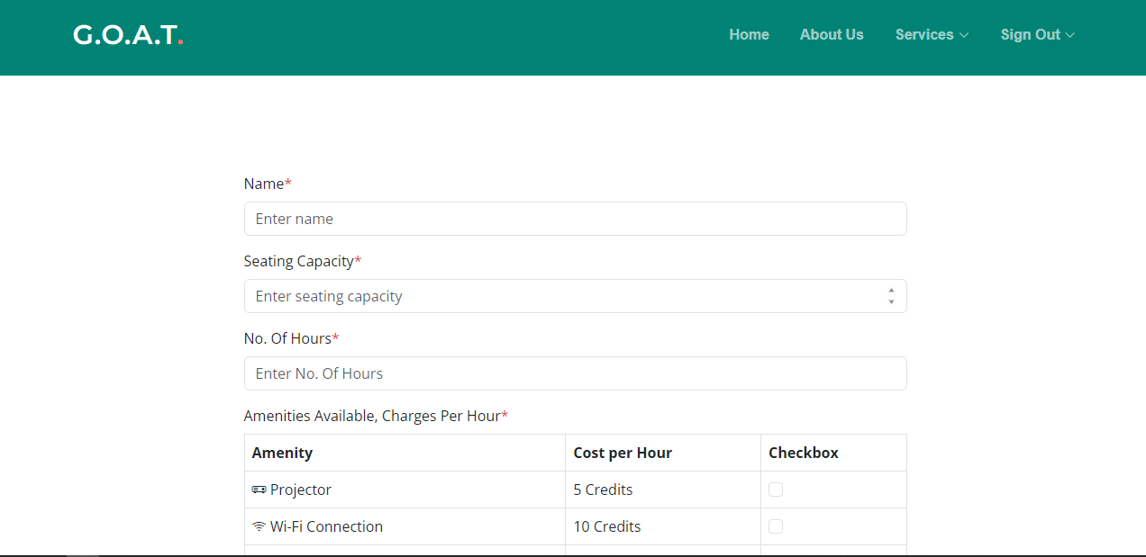
Create Meeting
add name, seating capicity fields
select amenities by checking box
save meeting

Slide 12

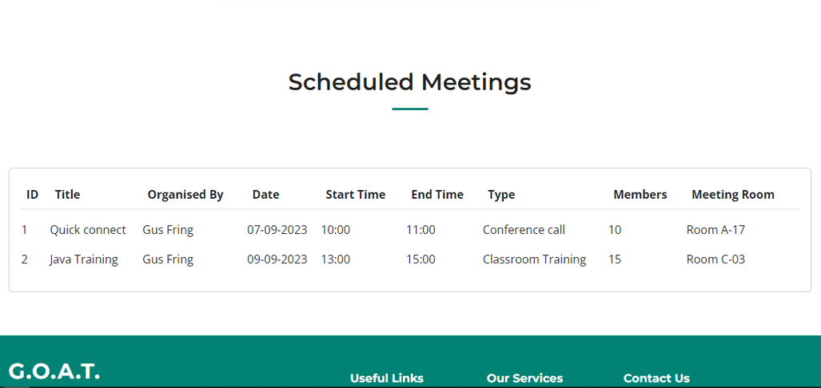
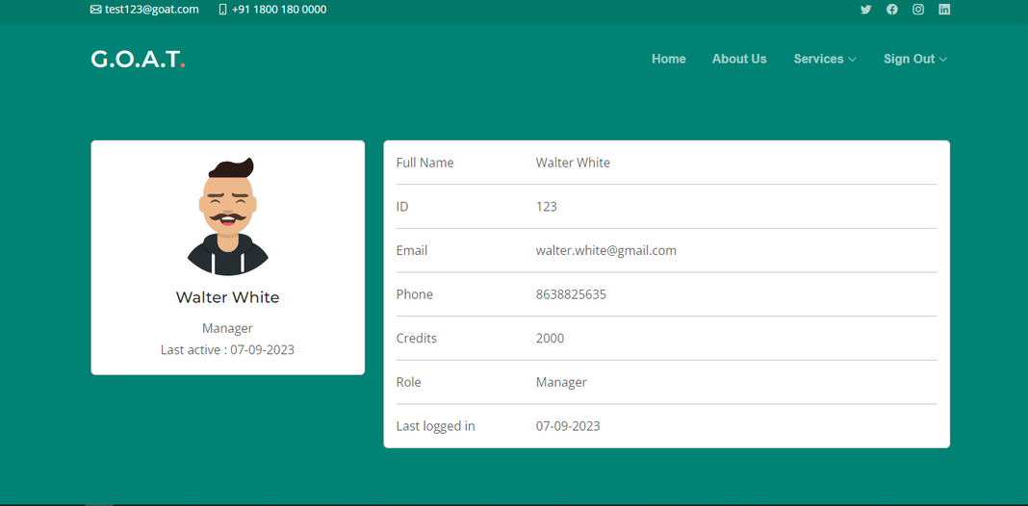
Manager Details
Details like Manager name ID, Email and Credits Shown here
Manager’s meetings shown here
save meeting

Slide 13

Thank you
www.goatmeetings.com

